Slide 1
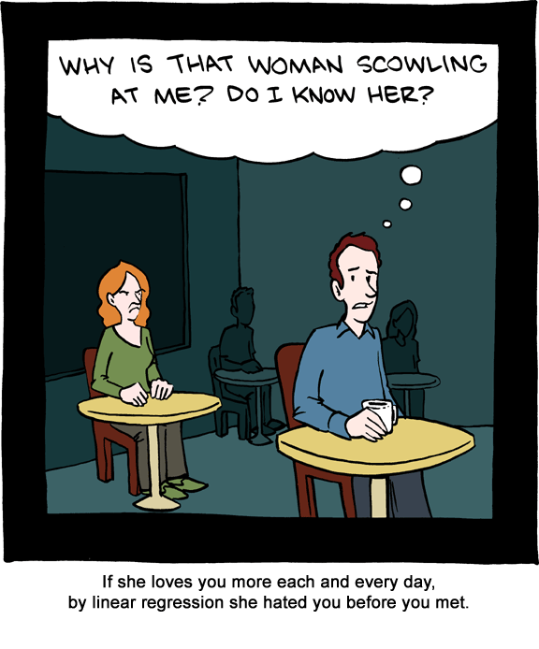
Chapter 12: Correlation and Linear Regression
http://jonfwilkins.blogspot.com/2011_08_01_archive.html

Slide 2
12.1: Simple Linear Regression - Goals
Be able to categorize whether a variable is a response variable or a explanatory variable.
Be able to interpret a scatterplot
Pattern
Outliers
Form, direction and strength of a relationship
Be able to generally describe the method of ‘Least Squares Regression’ including the model.
Be able to calculate and interpret the regression line.
Using the least square regression line, be able to predict the value of y for any appropriate value of x.
Be able to generate the ANOVA table for linear regression.
Be able to calculate r².
Be able to explain the meaning of r².
Be able to discern what r² does NOT explain.

Slide 3
Association
Two variables are associated if knowing the values of one of the variables tells you something about the values of the other variable.
Do you want to explore the association?
Do you want to show causality?

Slide 4
Variable Types
Response variable (Y): outcome of the study
Explanatory variable (X): explains or causes changes in the response variable
Y = g(X)

Slide 5
Scatterplot - Procedure
Decide which variable is the explanatory variable and put on X axis. The response variable goes on the Y axis.
Label and scale your axes.
Plot the (x,y) pairs.

Slide 6
Pattern
Form
Direction
Strength
Outliers

Slide 7
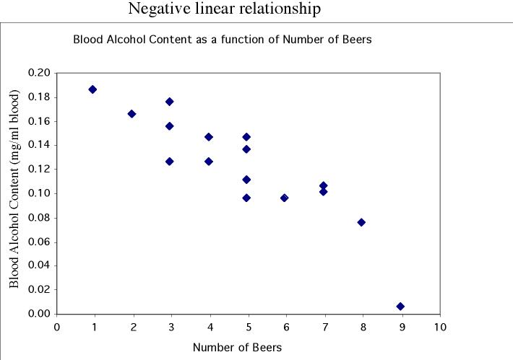
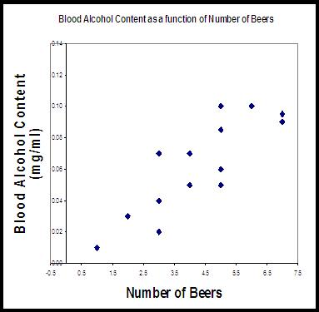
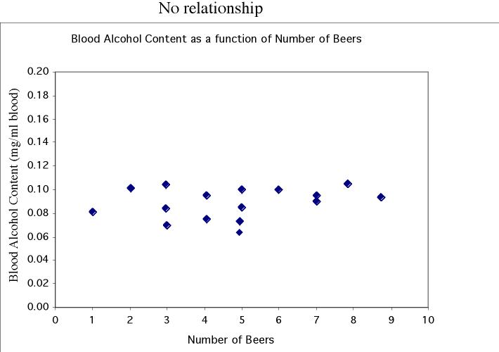
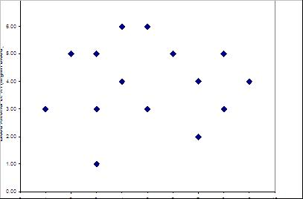
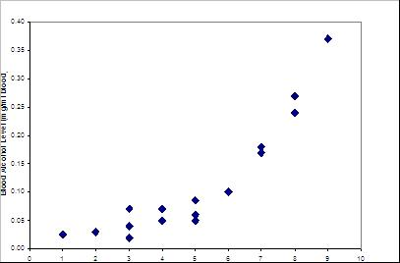
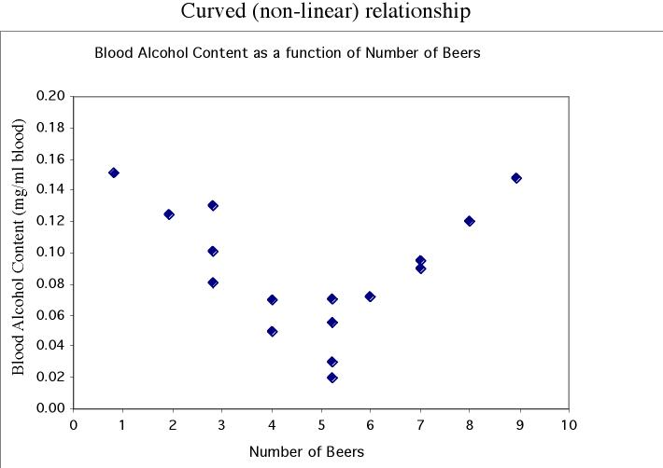
Pattern
Linear
No relationship
Nonlinear

Slide 8
Outliers

Slide 9
Regression Line
A regression line is a straight line that describes how a response variable y changes as an explanatory variable x changes.
We can use a regression line to predict the value of y for a given value of x.
Y = β₀ + β₁X
Y = β₀ + β₁X + ε

Slide 10
Notation
n independent observations
x_{i} are the explanatory observations
y_{i} are the observed response variable observations
Therefore, we have n ordered pairs (x_{i}, y_{i})

Slide 11
Simple Linear Regression Model
Let (x_{i}, y_{i}) be pairs of observations. We assume that there exists constants β₀ and β₁ such that
Y_{i} = β₀ + β₁X_{i} + ε_{i}
where ε_{i} ~ N(0, σ²) (iid)

Slide 12
Assumptions for Linear Regression
SRS with the observations independent of each other.
The relationship is linear in the population.
The response, y, is normally distribution around the population regression line.
The standard deviation of the response is constant.

Slide 13
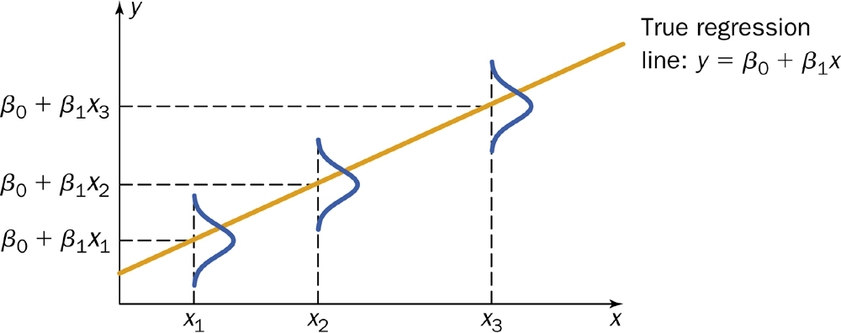
Normality of Y

Slide 14
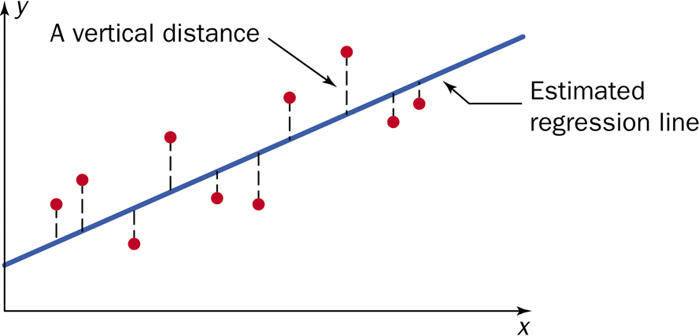
Linear Regression Model

Slide 15
Linear Regression Results
$$\hat{y}={\hat{β}}_{0}+{\hat{β}}_{1}x=b_{0}+b_{1}x$$
$${\hat{β}}_{1}=b_{1}=\frac{\sum{\left[\left(x_{i}−\overline{x}\right)\left(y_{i}−\overline{y}\right)\right]}}{\sum{{\left(x_{i}−\overline{x}\right)}^{2}}}=\frac{S_{XY}}{S_{XX}}$$
$${\hat{β}}_{0}=\overline{y}−{\hat{β}}_{1}\overline{x}$$
$$b_{0}=\overline{y}−b_{1}\overline{x}$$

Slide 16
Linear Regression - variance
e_{i} = y_{i} - ŷ_{i}
$$s^{2}=\frac{\sum{e_{i}^{2}}}{n−2}=\frac{\sum{{\left(y_{i}−{\hat{y}}_{i}\right)}^{2}}}{n−2}=\frac{SSE}{dfe}$$

Slide 17
Other SS and df
Total
$$SST=S_{yy}=\sum{{\left(y_{i}−\overline{y}\right)}^{2}}$$
dft = n - 1
Regression
$$SSR=\sum{{\left({\hat{y}}_{i}−\overline{y}\right)}^{2}}=b_{1}S_{XY}$$
dfr= 1

Slide 18
ANOVA table for Linear Regression
Source | df | SS | MS | F
Regression | 1 | Σ(ŷ_{i} - ȳ)²
Error | n – 2 | Σ(y_{i} - ŷ_{i})²
Total | n – 1 | Σ(y_{i} - ȳ)²

Slide 19
Facts about Least Square Regression
Slope: A change of y with one unit change in x.
$$b_{1}=\frac{rise}{run}$$
Intercept: the value of y when x = 0.
The line passes through the point (x̄,ȳ).
There is an inherent difference between x and y.

Slide 20
r²
Coefficient of determination.
Fraction of the variation of the values of y that is explained by the least-squares regression of y on x.
$$r^{2}=\frac{\sum{{(\hat{y}−\overline{y})}^{2}}}{\sum{{(y_{i}−\overline{y})}^{2}}}=\frac{SSR}{SST}$$

Slide 21
Beware of interpretation of r²
Linearity
Outliers
Good prediction

